Slide 1
#3.1 Color a planar map with 4 colors
States: a planar map with states as nodes and state connectivity as edges
Action: pick a state to color
Transition model: a state will have a color
Goal test: all states colored with no adjacent states with the same color.
Step cost: 1 for each step

Slide 2
#3.1 Monkey and Banana
States: just as described in the problem.
Actions: get_banana, move_crate, stack_crate, climb_crate, etc.
Transition mode: e.g., once monkey executes get_banana, it will have banana
Goal test: monkey has banana
Path cost: 1 for each action

Slide 3
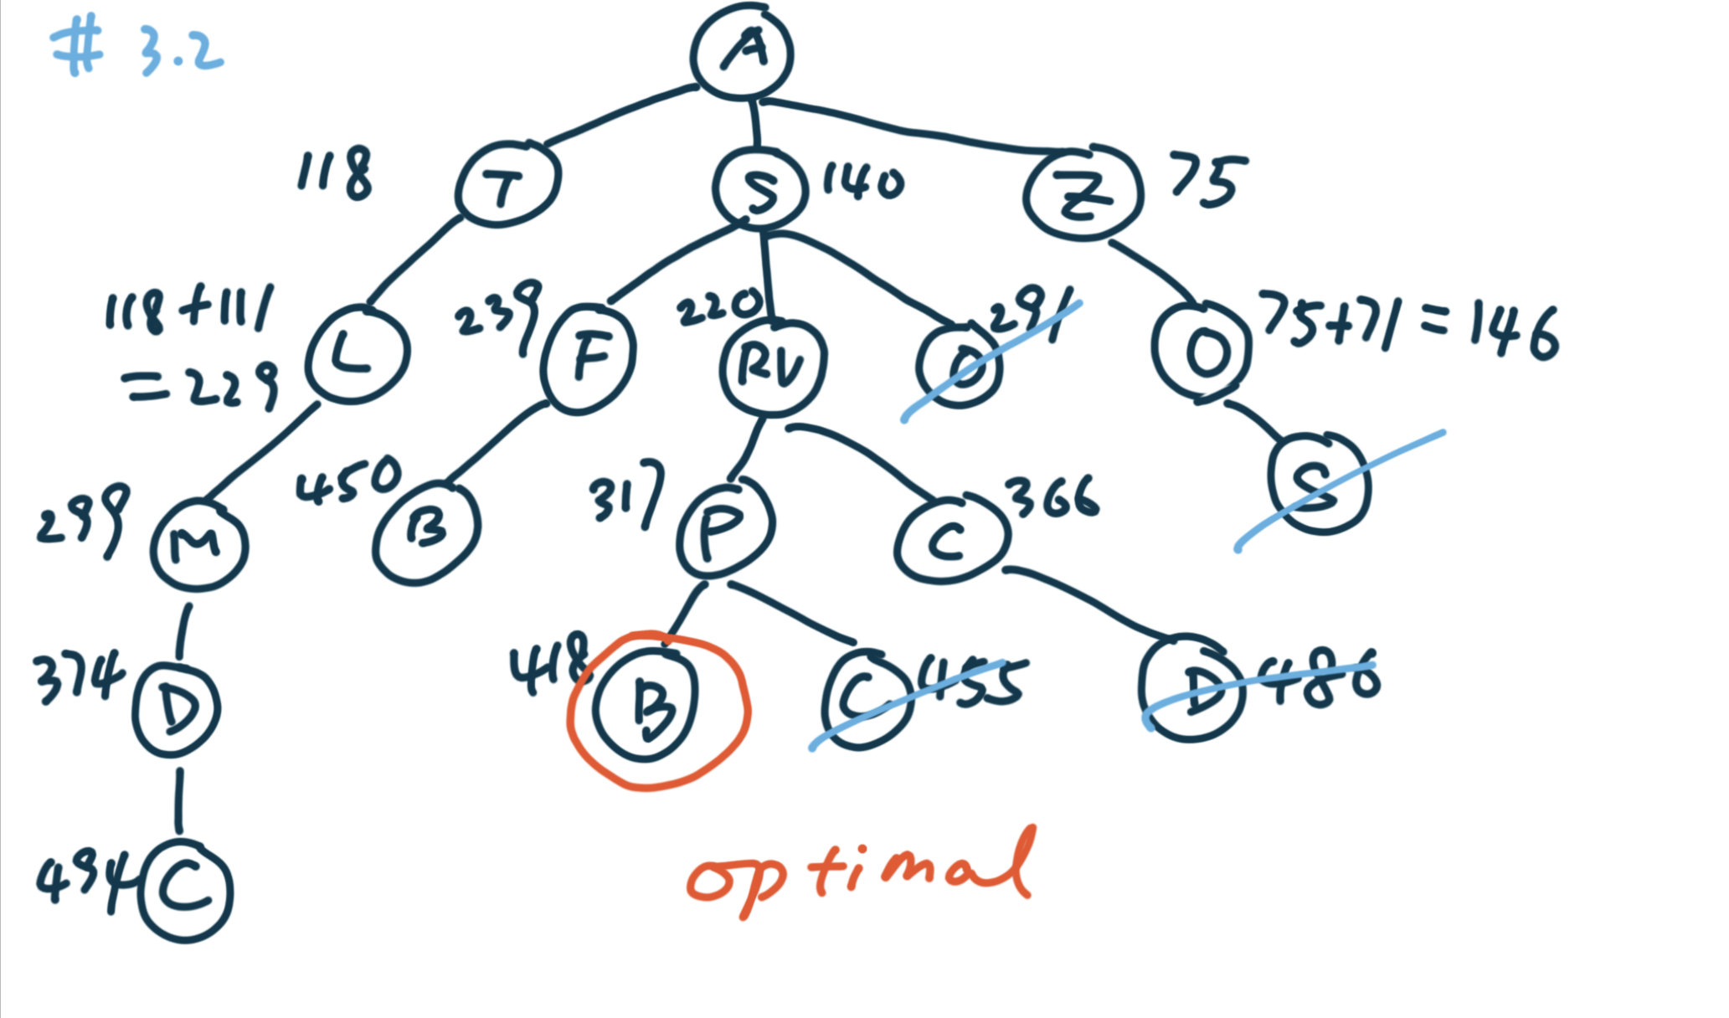
#3.2

Slide 4
#3.3
State: a representation of a physical configuration of the problem.
State space: how states are connected with each other through actions.
Search tree: start from some initial state, apply all possible actions; select the next state and apply all possible actions; continue the process until goal is found or no new nodes can be generated.
A finite state space doesn’t always lead to a finite search tree because there could be loops or repeated states.
A tree or a finite directed acyclic graph will always lead to a finite search tree since there’s no cycle/loop.

Slide 5
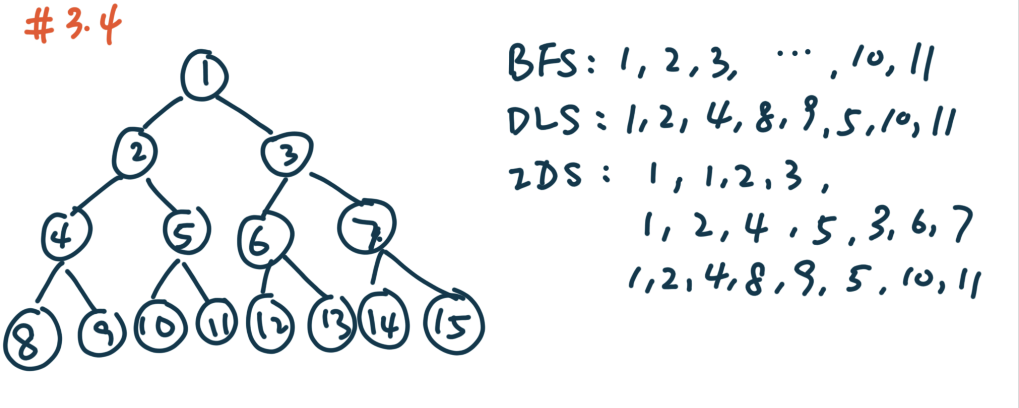
#3.4

Slide 6
#3.5
Uniform-cost search is optimal when implemented with graph-search algorithm. The search is strictly expanding nodes with increasing path cost g(n). The very first time when the search selects a node for expansion, we find the the lowest cost for that node. It’s not possible to expand to a node later (like in tree search) with a lower cost.
BFS with constant step costs is optimal with graph-search. The shallowest solution is the cheapest cost node with constant step costs.

Slide 7
#3.6
IDS will generate the shallowest solution, which will be {start, goal} with a path cost of 100.
The optimal solution should be {start, A, Goal} with a cost of 2.
Start
1
100
A
Goal
1

Slide 8
#3.7
1
Imagine the state space is a linked list
Depth first search cost will be O(n)
IDS will be 1 + 2+ … + n = O(n^2)
2
…
n

Slide 9
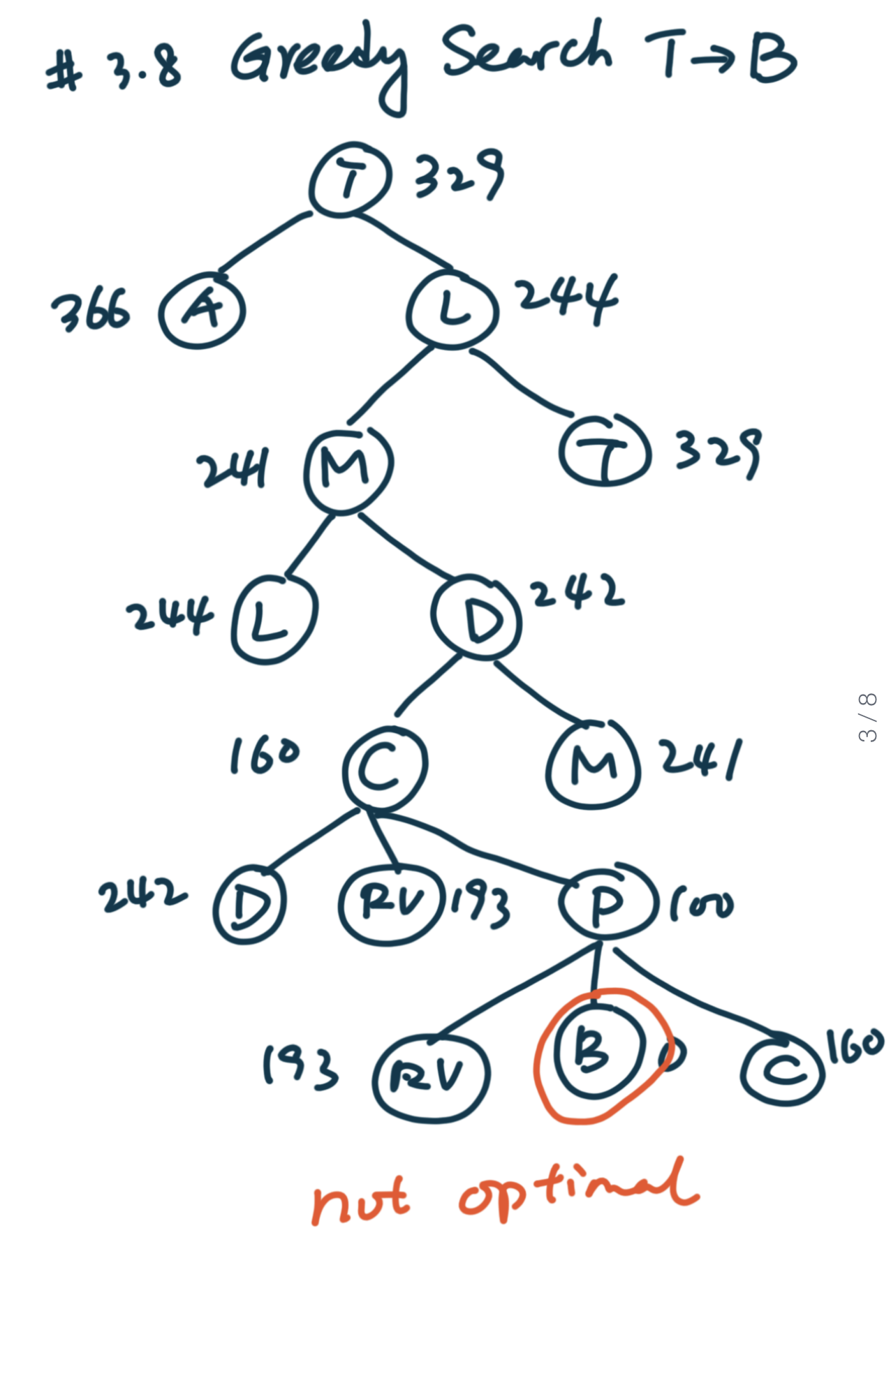
#3.8 Greedy Search + Tree Search

Slide 10
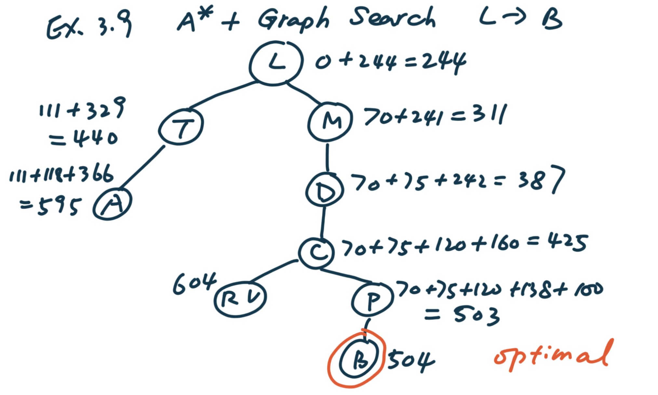
#3.9 A* + Graph Search

Slide 11
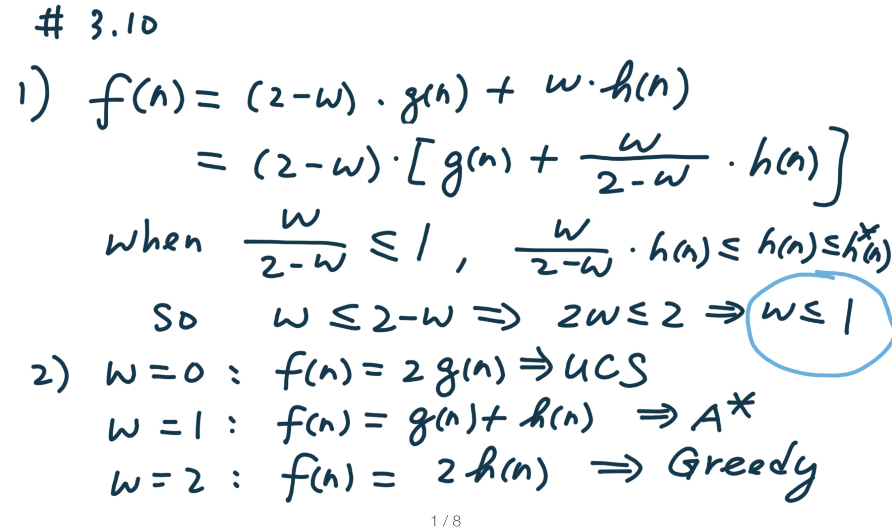
#3.10

Slide 12
#3.11
BFS is a special case of uniform-cost search when steps costs are identical or non-decreasing based on the depth of a node (both search will find the shallowest solution, which is the optimal solution)
BFS is a special case of best-first search when f(n) = depth(n)
DFS is a special case of best-first search when f(n) = 1/depth(n)
Uniform-cost search is a special case of best-first search when f(n) = g(n)
Uniform-cost search is a special case of A* when h(n) = 0. (hint: when h(n) = 0, f(n) = h(n) + g(n) = g(n), which is exactly UCS.)

